Slide 1
Title

Slide 2
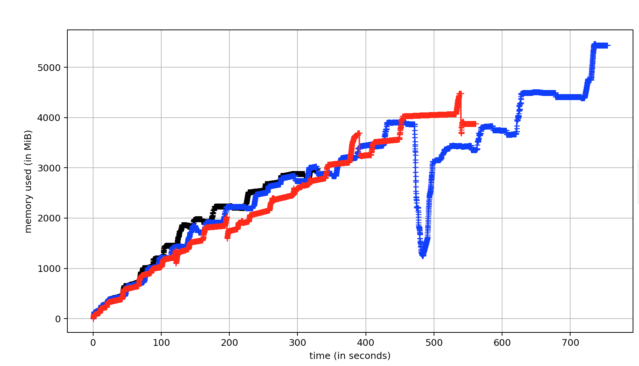
jemalloc
cl.MemoryPool
tbbmalloc

Slide 3
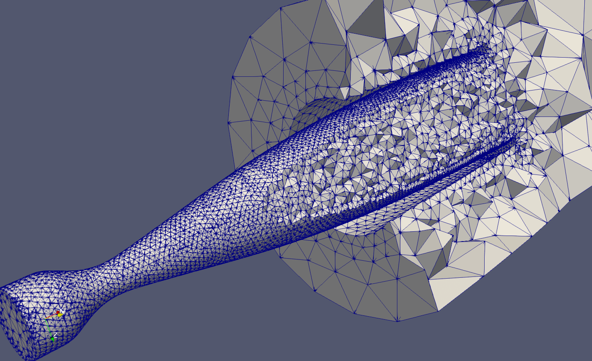
425mm, T_{s} = 1.1ms
107,554 Elements

Slide 4
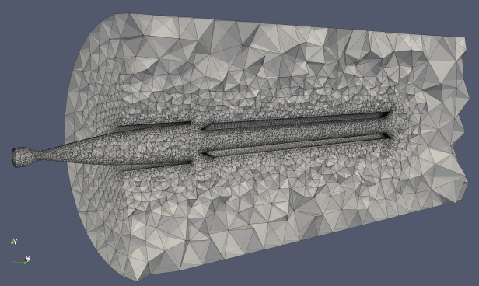
1.1m, T_{s} = 3ms
1M Elements

Slide 5
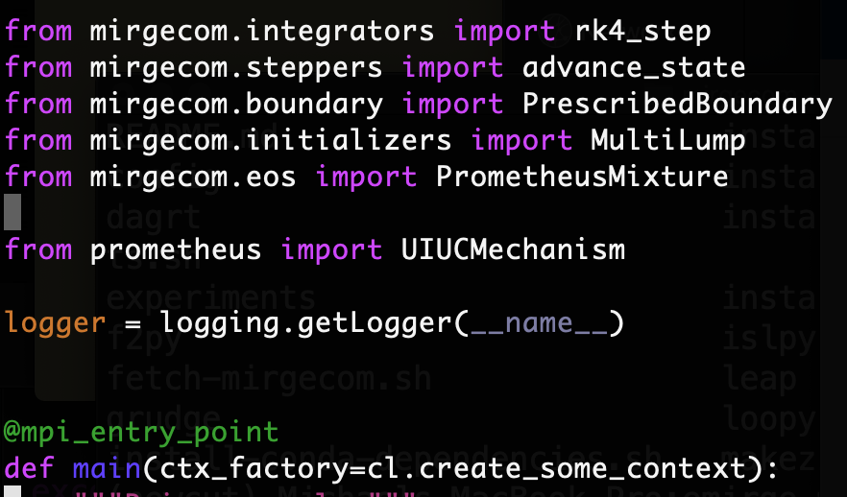
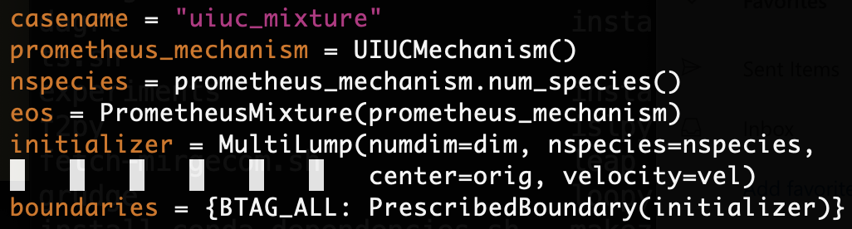

Slide 6
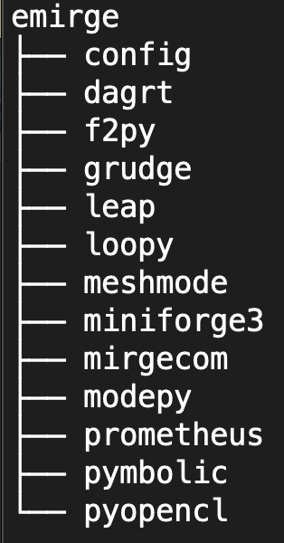
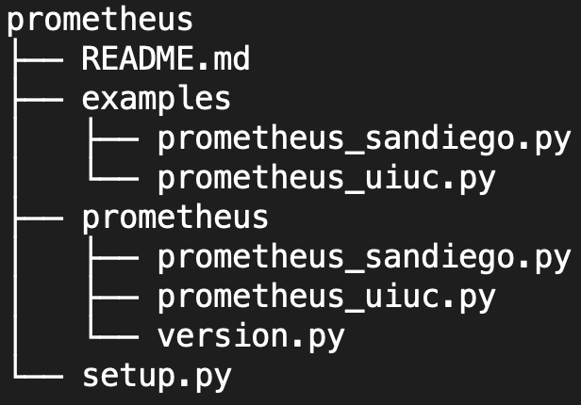

Slide 8

Quartz NFS single core VTK IO rates for mirgecom
Oberved Peak $≈74MBps$
IO BW (MB/s)
VTK Filesize (MB)

Slide 9
Time (s)
1
2
4
8
16
Number of Quartz Nodes

Slide 10
Time(s)
Number of nodes

Slide 11
Time(s)
Number of MPI ranks [8 nodes]

Slide 12
Time (s)
Number of elements

Slide 13
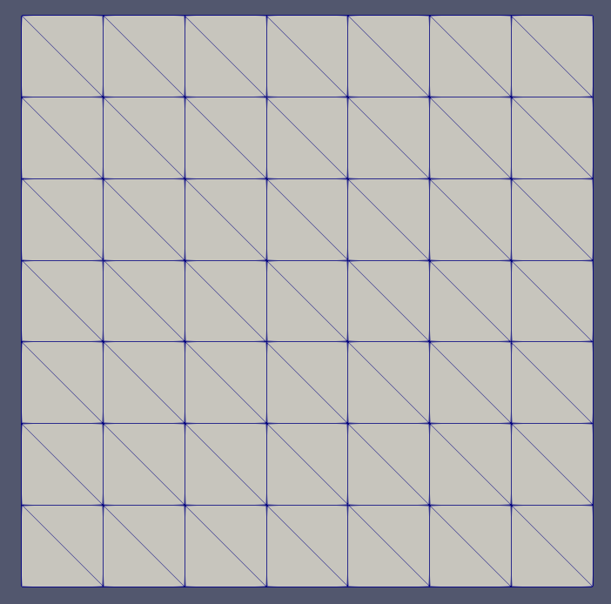
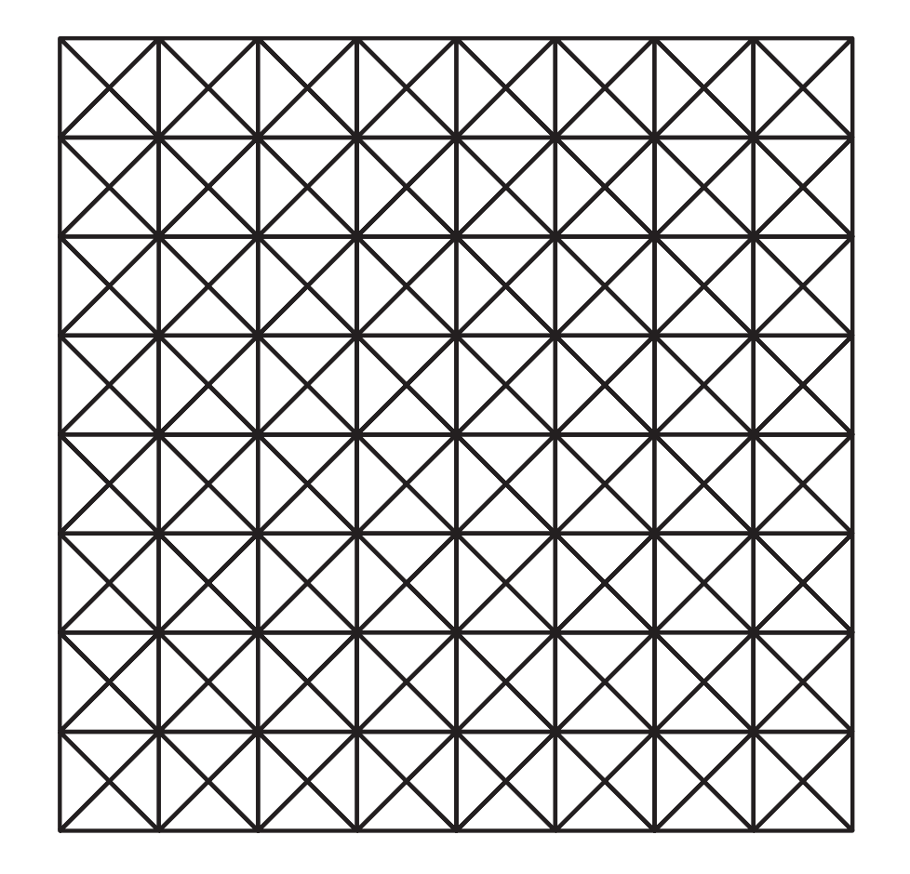
meshmode::generate_box_mesh
From DG book

Slide 14
Users Drivers & Experiments
Mirgecom
Loopy & MIRGE
Grudge
Meshmode
PyOpenCL
System
Metal

Slide 15
Users Drivers & Experiments
Mirgecom
Loopy & MIRGE
Mix API
Grudge
Mixture XML
Meshmode
PyOpenCL
Inline
Pyrometheus
(Python)
System
Metal
Cantera (TPL)

Slide 16
Users Drivers & Experiments
Mix
Mixture XML
Mirgecom
API
Loopy & MIRGE
Pyrometheus?
Grudge
Cantera
Meshmode
Port to Python
PyOpenCL
System
Prometheus
Metal

Slide 17
Users Drivers & Experiments
Mirgecom
Loopy & MIRGE
Pyrometheus
Grudge
Meshmode
PyOpenCL
System
Metal

Slide 18
Mixture API
(Python)
Mixture XML
Thermo
Prometheus
(C++)
Chemistry
Cantera (TPL)
Transport

Slide 19
MIRGE-Com
Mixture EOS
Mixture XML
Thermochem
Wrapper
Thermo
Pyrometheus
get_temperature
Chemistry
get_concentrations
Cantera (TPL)
Transport
MIRGE-Com

Slide 20
Combozzle mesh scaling on Lassen
100
p=1
p=2
p=3
Eager
10
Walltime/step (s)
1
p=1
p=2
p=3
Lazy
10K
100K
Number of elements

Slide 21
Combozzle GPU utilization (eager)
Utilization
Sample

Slide 22
Autoignition Test Eager vs. Lazy
100
Mac CPU
10
Eager
Lassen GPU
1
Walltime/step (s)
Lazy
Lassen GPU
.1
Mac CPU
2 4 6 8 10 12 14 16 18 20
Number of Newton iterations

Slide 23
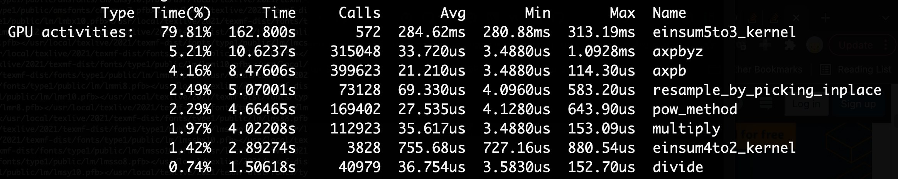
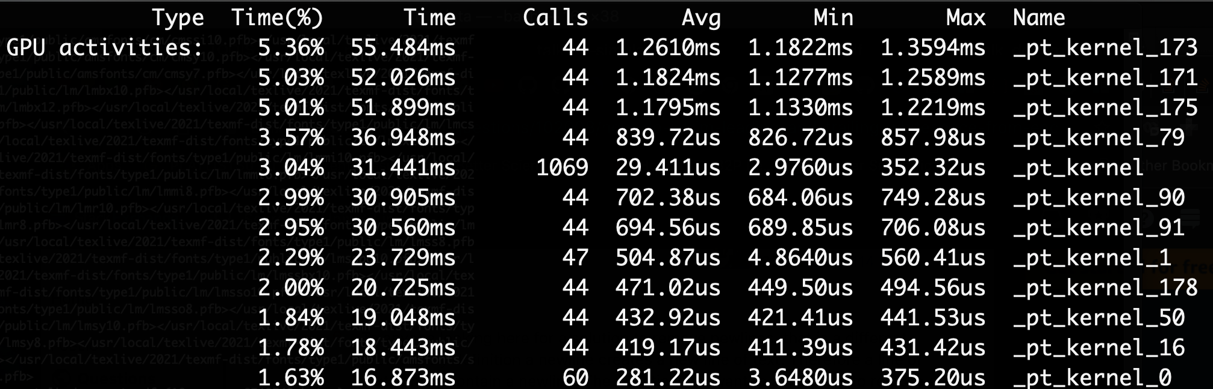
nvprof: Eager
nvprof: Lazy

Slide 24
Combozzle GPU utilization (lazy)
Utilization
Sample

Slide 25
GPU Memory (MiB)
Sample

Slide 26
GPU Memory (MiB)
Sample

Slide 27
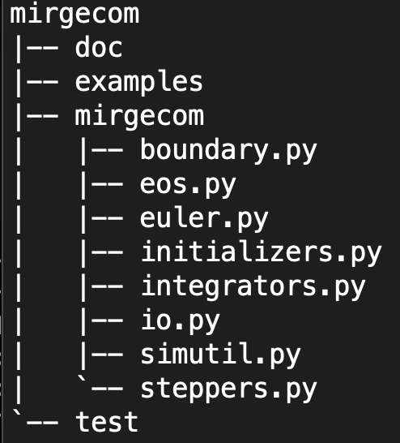
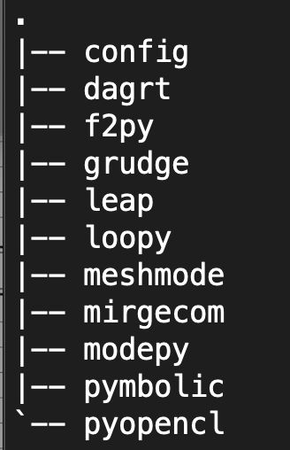

Slide 28
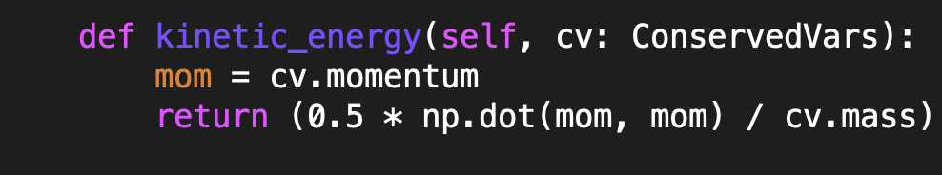
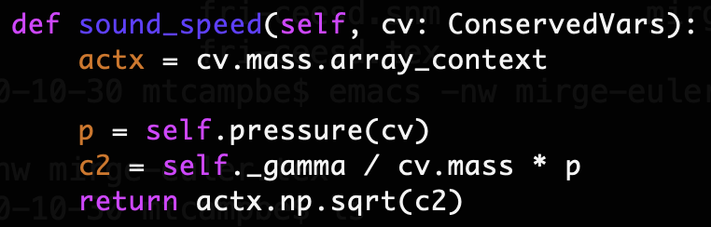

Slide 29
BC
(q*)⁺
(q*)⁻
(q*)⁺
(q*)⁺

Slide 30
(q*)

Slide 31
(q*)

Slide 32
(q*)
(q*)
(q*)
(q*)

Slide 33
(q*)
(q*)
(q*)
(q*)

Slide 34
(q*)
(q*)
(q*)
(q*)

Slide 35
(q*)
(q*)
(q*)
(q*)

Slide 36
^
n
(q*)
^
^
n
(q*)
n
(q*)
(q*)
^
n

Slide 37
^
n
(q*)
(q*)
(q*)
(q*)
^
n

Slide 38
(q*)
(q*)
(q*)
(q*)

Slide 39
(q*)
(q*)
(q*)
(q*)

Slide 40
(q*)
(q*)
(q*)
(q*)

Slide 41
(q*)
(q*)
(q*)
(q*)

Slide 42
(q*)⁻
(q*)⁺
(q*)⁺

Slide 43
Typical MIRGE-Com Simulation Driver
Create Array Context
(GPU, CPU)
Grid Generation (Serial)
Create DG Discretization
(Eager, Lazy)
Decomp (Metis)
Solution Initialization
Configuration (Q, RHS, S, EOS)
Time marching
Status Reporting
Viz I/O
VTK

Slide 44
(q*)
(q*)
(q*)
(q*)

Slide 45
(q*)
(q*)
(q*)
(q*)

Slide 46
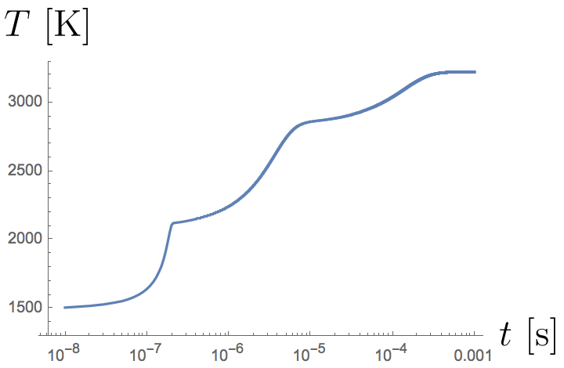
Prometheus
MIRGE-Com

Slide 47
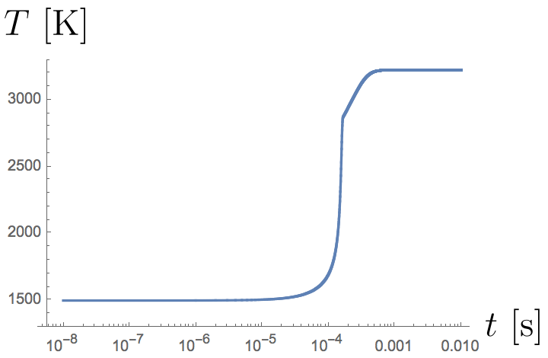
Prometheus
MIRGE-Com

Slide 48
2.5
p=3
2.0
p=2
1.5
RK4
Walltime/step (s)
p=1
1.0
p=3
0.5
Euler
p=2
p=1
0
0
20000
40000
60000
80000
100000
120000
Number of elements

Slide 49
3.9
p=3
3.8
3.7
TS Ratio
p=2
RK4/Euler
3.6
p=1
3.5
3.4
0
20000
40000
60000
80000
100000
120000
Number of elements

